Slide 2

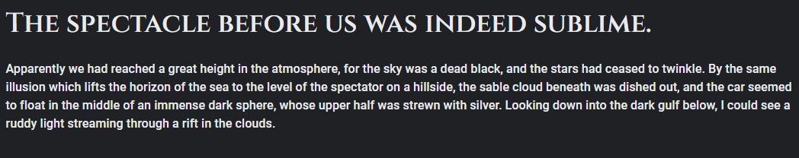
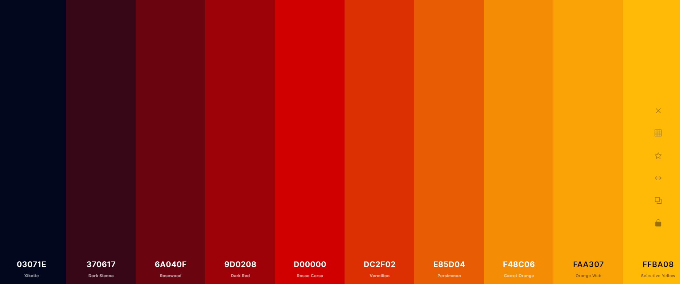
Font: Cinzel & Roboto
Logo:
Fonts: Cinzel & Roboto
Color Palette

